Slide 1
Live session 5 Effectively Communicating Results
Experimental Statistics II

Slide 2
Tonights Agenda
Open conversation about the project write ups (Pre Live Assignment)
Discussion of some technical details that tend to pop up during project time
Effective Communication of Results
Pitfalls
Organization (The true process vs the one you present)
Additional Technical Strategies

Slide 3
Technical Question #1
Is it required that each predictor needs to be normally distributed in a regression model?

Slide 4
Technical Question #2
Is it required that each predictor needs to be normally distributed in a regression model?
ANSWER: NO
Recall that if this was true, then we would never be able to include dummy variables or categorical variables since they are clearly not normally distributed. The requirement is solely in the errors.

Slide 5
Technical Question #1
Simple example

Slide 6
Techincal Question #1
Residuals are still normally distributed so there is nothing wrong.

Slide 7
TQ#2 Which of the following qq-plots indicates that the data is not normally distributed?

Slide 8
TQ #2 Which of the following qq-plots indicates that the data is not normally distributed?

Slide 9
ANSWER
They all are coming from the normal distribution!
THE POINT
With smaller sample sizes, normality can be really hard to assess from data set to data set. As you just saw. It is also true the other way around (data is actually not normal but the qqplot supports normality)
With larger data sets, regression coefficients have Central Limit Theorem type properties, so the t-test is still valid regardless if the residuals are normal or not. (This is true for normality only, large sample size does not get us around nonconstant variance issues or valid prediction intervals.)

Slide 10
Cross Validation and Train/test Splitting
Motivating question: Why does Turner have me splitting the data set into train/test/validation (3 data sets) on the project, instead of just two from HW.
Important Distinction. Computing the test ASE metric can serve 2 functions:
Model Selection: To assess the bias variance trade off of competing models (both within the same method and between different methods)
Model Assessment: To use the ASE or Root ASE, as direct indication of how well your model is going to predict future values from the same population your training data is coming from

Slide 11
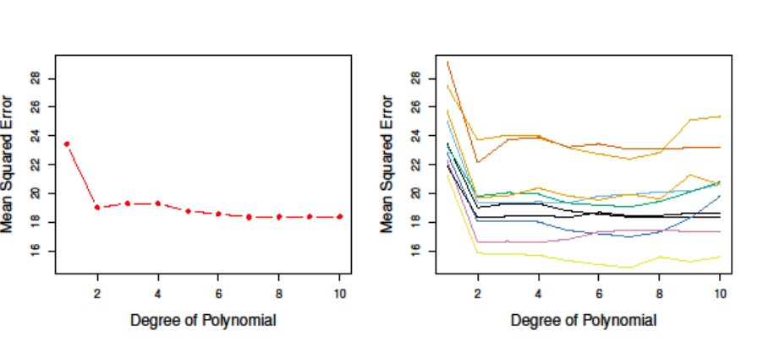
Cross Validation and Train/test Splitting
Model Selection
The actual value of the metric doesn’t really matter. We are just comparing
Model Assessment
The actual value will be used to think about future predictions.
For example, suppose the response is predicting household income (unit of measure in 1,000s).
A test ASE of 18 corresponds to a RASE of 4.24. This is the standard deviation of your predictions relative to the truth.
Assuming normality, your models prediction are off by about +/- 2 RASE or +/-8.48.
So when predicting household income, are predcitions “margin of error” is roughly 8,480 dollars. Can we live with that type of accuracy? Or do we really need that to be more like 3,000?

Slide 12
Cross Validation and Train/test Splitting
Criticism of the train/test split approach alone
Its possible to ”game the system” by considering multiple train/test splits, build your models, and then report the best test ASE using the split that produced it. Then reporting that your predictions will be within that type of error range on future data sets
This approach biases the test ASE into looking too small
It really helps no one. It can make you look bad if your model doesn’t perform as well in the future. People may make decisions using your model that produces error that they can’t live with in reality.
It can impact model assessment, but is not much of an issue with model selection (see graph)
One Split
Many Splits

Slide 13
Cross Validation and Train/test Splitting
Motivating question: Why does Turner have me splitting the data set into train/test/validation (3 data sets) on the project, instead of just two from HW.
Answer: Even if we stay honest and just randomly pick our training and test set. As you fit more and more models and methods, you are fixating all of your decisions on bringing down the test ASE.
If we do this to the nth degree (which we typically do), then the test data set, is really helping you train your model. You should start thinking about it that it is just an extension of the training data set, and the ASE that comes from it could be biased too low.
In comes the validation set. You leave it out. Never look at it. Build your models using train/test. Make your final decision. Then ASSESS how well your model performs on the Validation set. It it is low and in the realistic range you are looking for, then you have validated your model as working as you intend.
You can cheat the validation set as well of course by rinse a repeating the issue. You keep building models with the train/test and then compare the validation result and then based on all 3 you make your model choice. Then you haven’t validated that model yet. You’ll need another data set to do that.

Slide 14
The Moral OF the STory
You can cheat all day and make your predictions look awesome. Maybe that’ll get you hired or impress someone at a meeting or a talk.
You don’t want that impression to where off though. Don’t cheat yourself by taking low hanging fruit. They need the truth so any decisions being made from your models will be in the best possible position. Be aware of the difference between using test ASE’s for model selection versus model assessment.
Since K fold CV allows for repeated models to be fit, we are able to asses how much variance is between different train/test splits. So a CV metric, doesn’t suffer as much from biasing test ASE too low. It can help serve the role of both model selection AND model assessment.
This is why packages like Caret in R utilize K fold (and other resampling strategies) in all of their routines. When they do a train/test split, the test set can serve as the validation set since all of your ASE metrics are done Via CV.
They use them to determine model complexity for a single method
You can compare them across methods (as long as you use the same seed number)
All feature selection process are done with the training data so the test set from these routines are serving the validation set role. (Again being wary of using the validation set to decide what your final model is)

Slide 15
Dealing with Missing Data
Typical strategies include:
Building regression models with complete data and then predicting the missing scenarios. (Typicall MLR or KNN)
Replace missing numeric values with mean or median
Randomly sampling numeric or categorical values and replacing the missing with those
Important consideration to think about before doing all of that work and effort.
If your variable is missing a large %, is it even a reliable measurement? Can you trust the value itself.
If its personal type data, maybe its bogus, because most people don’t want to give it up and those who do just lie. (I do it when video game websites ask for my birthday)
Why would you want to use something in your model that will never truly get recorded in future data sets that often?
If the variable is reliably measured, makes sense, and missing is somewhat manageable (70% and up), then its worth exploring if it plays a critical role in the models you build.
If you have other models that do just as good, but have complete data compared to a model that has a variable with a lot of imputation, it’s probably more reliable and more comforting to go with the model using complete data without a whole lot of missing.

Slide 17
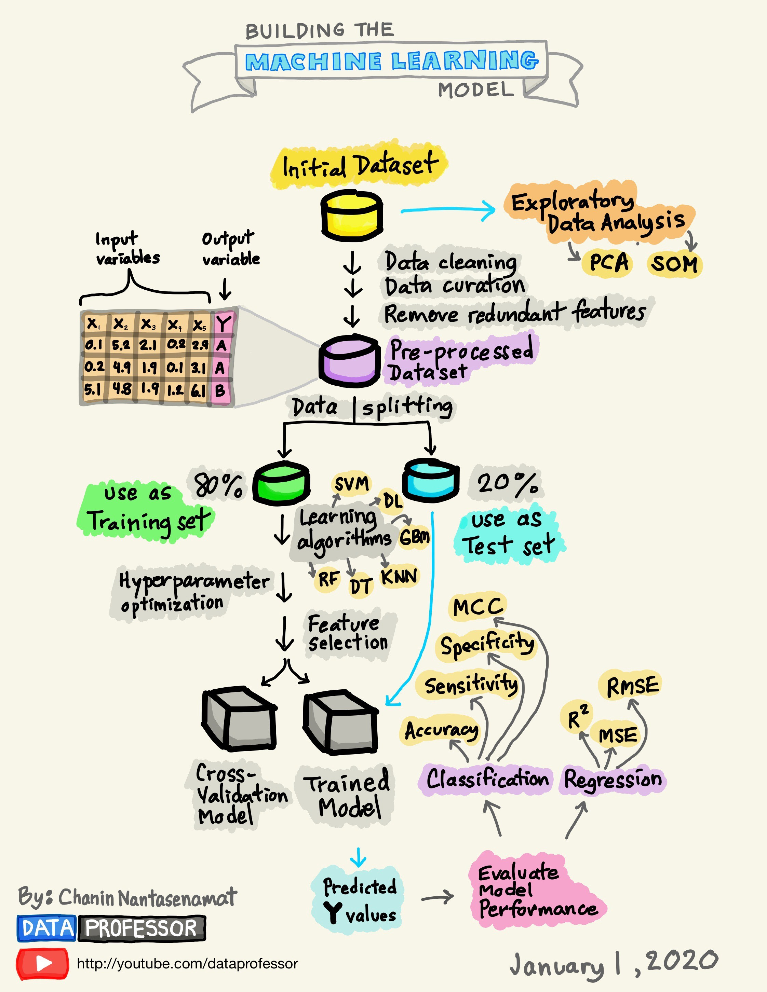
Effective Communication of your analysis and its results
Theoretical
Actual

Slide 18
Effective Communication of your analysis and its results
Actual process is highly iterative, lots of trial and error, fixing mistakes, gaining insight, etc.
When presenting results (written or oral), we should really try to summarize our analysis and results in a simpler way (mimick the theoretical)

Slide 19
Data Description
Data are code all sorts of ways. Some are categorical but recorded as numerical and vice a versa.
People will handle things differently. For example you may have a predictor called year that takes on 12 different values. You may want to treat it as categorical while someone else may treat it as numeric
The point: When providing data descriptions of the variables, it’s a good idea to report what data type YOU are treating the variable.

Slide 20
Processing Data (Stay Consistent)
Even though you have iterated and learned a lot once you’ve finalized your model, it is important to make sure that the way your models are built are consistent.
Example:
Group members do their data splits and complete building the objective 1 model. They use just the complete rows of the data set and do not handle the missing.
During the building of models to serve the role of just predicting, they impute the data and build models from there.
They compare all of their models including the one from objective one.
Problems:
Its not really apples to apples comparisons since the same train/test sets were not used
Manipulating data in the middle of the analysis will usually confuse people and the worst case, be suspect of why you are doing it and why you didn’t do it for the analysis you presented before mentioning it.
Depending on the changes you are making to the data set mid report, many times they will be eager to see new EDA from that perspective so they can see how things have changed.

Slide 21
Processing Data (Stay Consistent)
Solution: Although you will be iterating, try to keep a “line in the sand” between your data set and all the models. Ask yourself:
Are all the models created from the same training set?
Is my eda reflecting the data set that the models are being trained on?
Am I doing a good job of summarizing the processing steps early in the document and not mixing it in when models are being discussed and reported?
The only time you should blend Data Processing with another part of the report is in EDA when you may want to motivate why you’re taking the log of certain predictors or the response, why you’re creating a dummy variable from a numeric variable, etc.
When you do this blending, just make sure it is clear that you have communicated, and actually did, solutions 1 and 2 in the end.

Slide 22
EDA (Summary Statistics)
Summary statistics…..They need to be there. Every time. If not front and center, then place it in the appendix or back of the slide deck. They are so helpful, especially if questions come back.
For example, lets say you run knn on predictors that are z-scored. Someone asks why. You show them your summary statistics, show them that they are all on different scales (using standard deviation means, min/max, etc), and that knn doesn’t work well when the scales of the predictors are all different. Rather than just say “because it’s the right thing to do”, you provide a little more insight/evidence.

Slide 23
EDA (Graphics)
Do not let graphics (and tables) do the talking for you. Assume the reader has no clue how to read what’s going on.
If the graph is busy and all of the information is not necessary, then focus the readers attention somehow or make a new graph.
When writing, also assume that the reader will not look at a graph until you reference in your writing somehow. If you don’t reference it, then they may never even look at it because you never told them too. (Not really an issue for presentations)
EDA can be very messy and what you do to gain insight may not be the graphs you should present (or focus on). I’ll elaborate with examples.

Slide 24
EDA (Graphics)

Slide 25
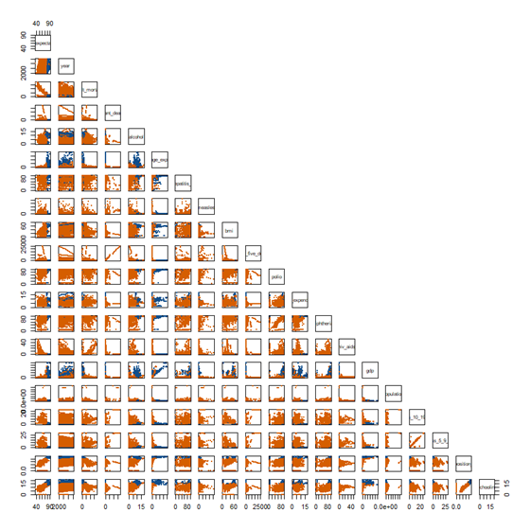
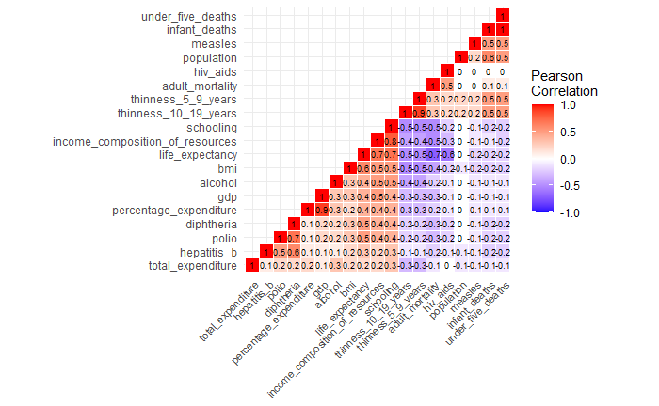
EXHIBIT B: How long does it Take you to see what they are talking about? Which graph? Both? Do we even get a feel for the MISSIng DATA with these graphs?
The following four variables are removed based on the multicollinearity among certain variables and having too many null values: Thiness.5.9.years, GDP, under.five.deaths, Population

Slide 26
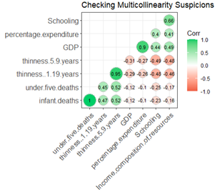
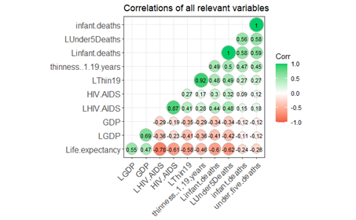
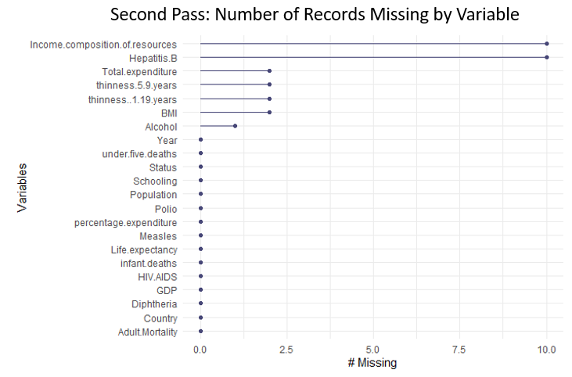
EXHIBIT A: Better Strategy and all figures were directly referenced in their writing

Slide 27
EDA: Show US some of the trends
There are strong correlations between life expectancy and …anything.
Are they even linear? Is there anything interesting happening with the trends? Weird things? Outliers? No idea. Can’t see.

Slide 28
EDA: Show US some of the trends
Remember!!! You know what your final models look like and which predictors are going to be in them.
Use this to help build a cohesive story to transition of EDA to your model fitting and reporting
When people finally see your model, you want them going “Yes! that makes sense based on what we’ve seen so far.”
Pluck out a few variables to highlight. Or strategically build graphs so the focus is more direct.
Big graphs are good for you the analyst but not so much for everyone else)

Slide 29
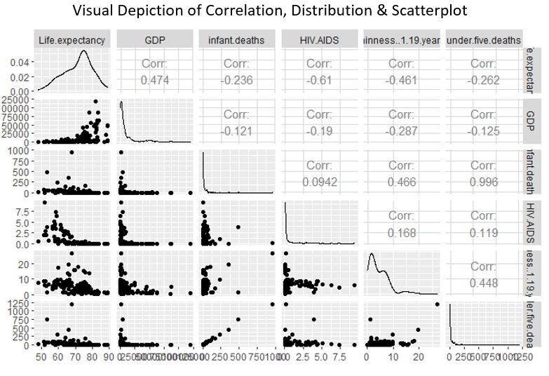
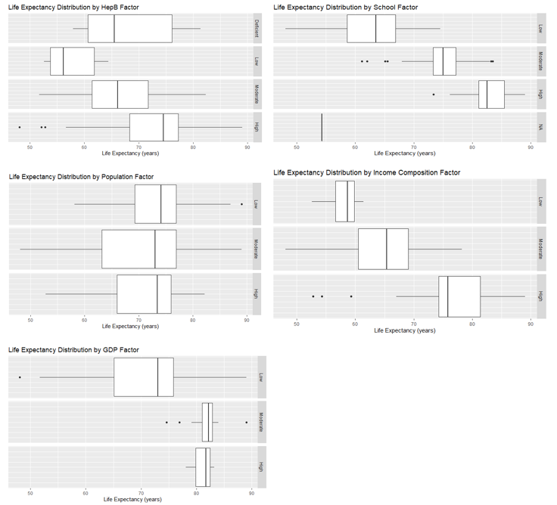
EDA: Show US some of the trends. Parse them out to draw focus.

Slide 30
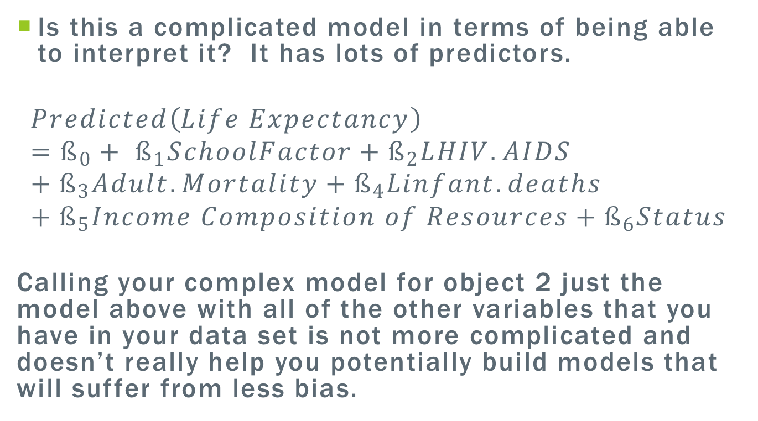
Building complex models
Is this a complicated model in terms of being able to interpret it? It has lots of predictors.
$$Predicted\left(Life Expectancy\right)=ß_{0}+ ß_{1}SchoolFactor+ß_{2}LHIV.AIDS+ß_{3}Adult.Mortality+ß_{4}Linfant.deaths+ß_{5}Income Composition of Resources+ß_{6}Status$$
Calling your complex model for object 2 just the model above with all of the other variables that you have in your data set is not more complicated and doesn’t really help you potentially build models that will suffer from less bias.

Slide 31
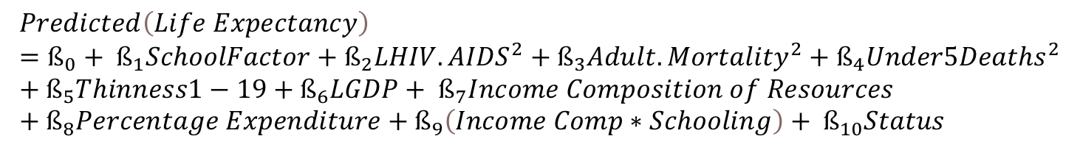
Building complex models
Get interaction terms or polynomial or other exotic transformations that make sense to capture nonlinear patters
Which ones to put in and use?.
EDA guidance, Subject matter logic
Trial/Error (numeric interactions are easiest to simply try).
For categorical interaction: Examine the response with the two variable like a 2 way anova analysis.
For 1 cat, 1 numeric, plot scatterplots color coded by group. As long as the number of levels is manageable. Can always fit simple linear regression model with just the two predictors and assess.
$$Predicted\left(Life Expectancy\right)=ß_{0}+ ß_{1}SchoolFactor+ß_{2}{LHIV.AIDS}^{2}+ß_{3}{Adult.Mortality}^{2}+ß_{4}{Under5Deaths}^{2}+ß_{5}Thinness1−19+ß_{6}LGDP+ ß_{7}Income Composition of Resources+ß_{8}Percentage Expenditure+ß_{9}\left(Income Comp∗Schooling\right)+ ß_{10}Status$$

